Slide 1
Machine Learning for Electrode Motion Removal in EGC signals.
Ben Russell

Slide 2
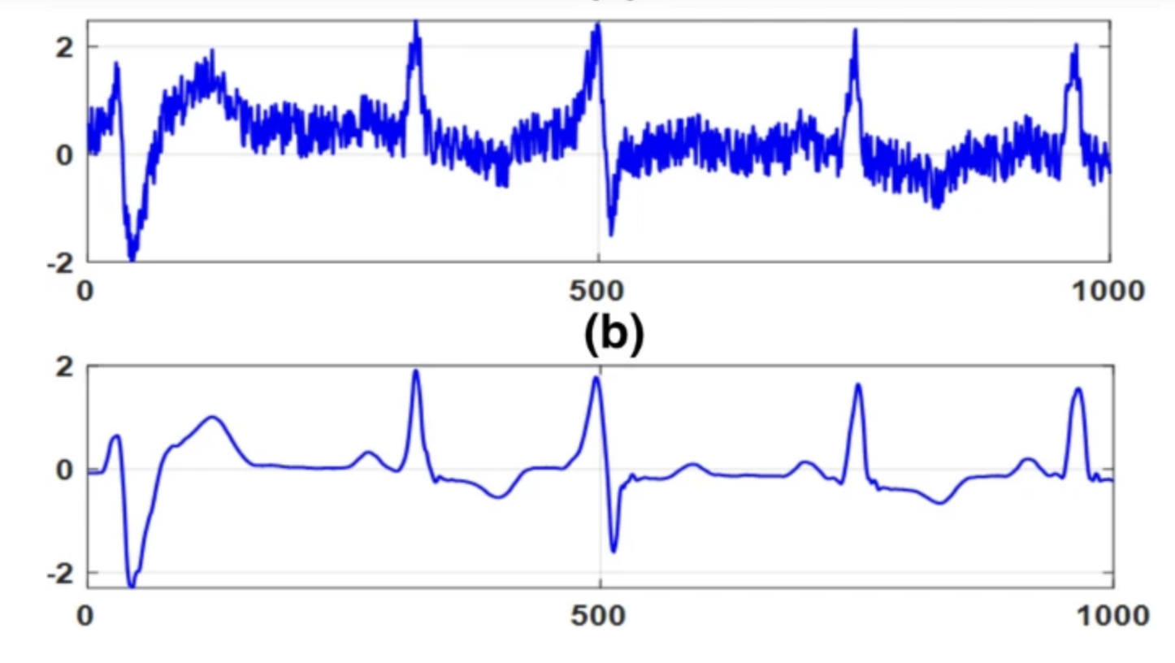
Problem Statement
Electrocardiographs (ECG’s) can be corrupt with 4 primary sources of noise:
Noise Source | Typical Frequency Range (Hz)
Baseline Wander | 0.1 – 1
Electrode Motion | 1 – 10
Powerline Interference | 50 / 60
Muscle Artefact | 10 - 1000
A typical ECG signal contains frequency components between 1 and 50 Hz.
Electrode Motion, Powerline Interference and Muscle artefact can all overlap with the frequency spectrum of an ECG.
This leads to distortion.
To remove distortion, digital filters can be used to minimize noise.
However, digital filters are typically only effective if the noise is linear and stationary.
Electrode Motion and Muscle Artefact are non-linear and non-stationary.
Electrode Motion directly overlaps with the P, QRS, and T waves, making it extremely difficult to remove with traditional filters.

Slide 3
Work Done to date
Objectives
A reference database has been created with the following objectives:
ECG signals completely devoid of noise are generated. These will act as a ground truth.
ECG signals are corrupt with Electrode Motion noise.
The clean signals contain a large variation of morphologies. This refers to the shape of the P wave, QRS complex, T-Wave and Heart Rate.
There is a large variation of noise signals that are being added to the signal.
Methodology
To achieve each of the objectives listed above:
Clean ECG signals were derived from 1st order differential equations modelled on the electrical signal of the heart.
30-minute Electrode Motion noise file was extracted from Physionets’ Noise Stress Test Database (NSTDB) and linearly added to the clean ECG signal.
The features within each ECG cycles (P, QRS, T) were iteratively altered using Latin Hypercube sampling.
Auto-regression modelling was used to estimate a large noise database, using the 30-minute record as an input.

Slide 4
Plan for the remainder.
Algorithm Development
1. Model Selection: Evaluate various machine learning (e.g., SVM, Random Forest, PCA with KNN) and deep learning models (e.g., CNN, RNN with LSTM, Auto Encoders, GAN’s).
2. Training: Train models using the reference database, optimizing for noise removal efficiency. An enhanced Loss function (WEDD) will be employed in an attempt to improve learning capability.
Validation
Performance Metrics: Statistical measures for time series signals such as SNR improvement, RMSE, Cross-Correlation will be used. Furthermore, a diagnostic performance metric designed specifically for ECG signals (Wavelet Energy Based Diagnostic Distortion) will be employed.
Testing: Performance will be tested on real world signals and unseen data generated synthetically.

